Slide 1


SRF FINAL PROJECT
ADMIN PORTAL AND TEACHER PORTAL

Slide 2







PROJECT ABSTRACT
TO SHOW STUDENT INFORMATION TEACHER PROFILE
TO GENERATE STUDENT
ID CARD Using Crystal Report
ATTENDANCE ENTRY
TO SHOW PARENT INFORMATION GRADE ENTRY
TO UPLOAD DOCUMENTS STUDENT DETAILS
TO UPLOAD STUDENT PHOTO PERFORMANCE REPORT

Slide 3


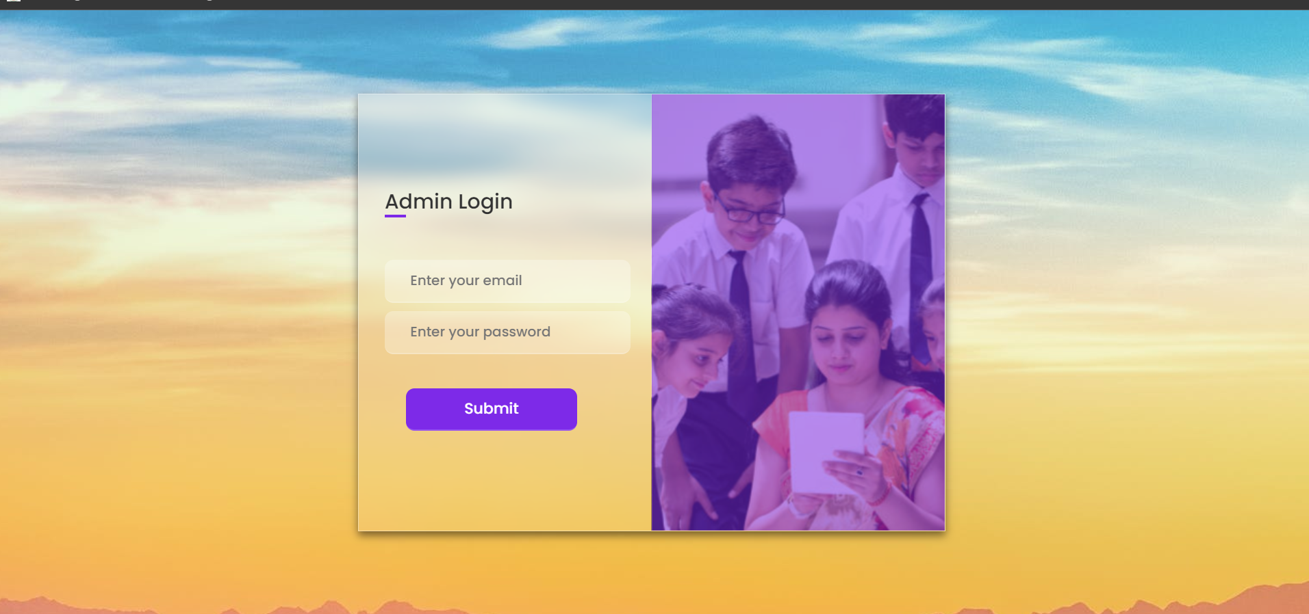
ADMIN LOGIN PAGE
In this page I have been using database authentication to authorise the Admin.

Slide 4
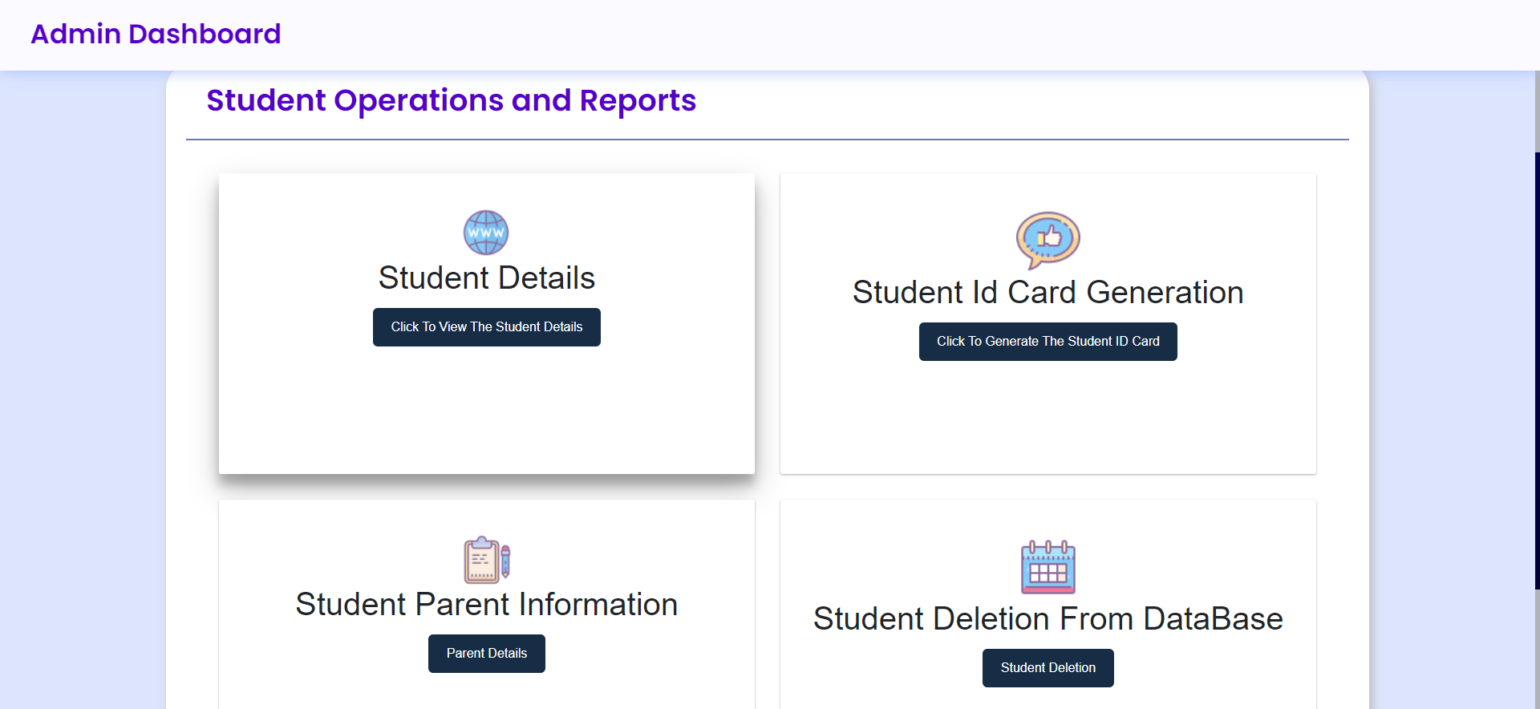
ADMIN DASHBOARD

Slide 5
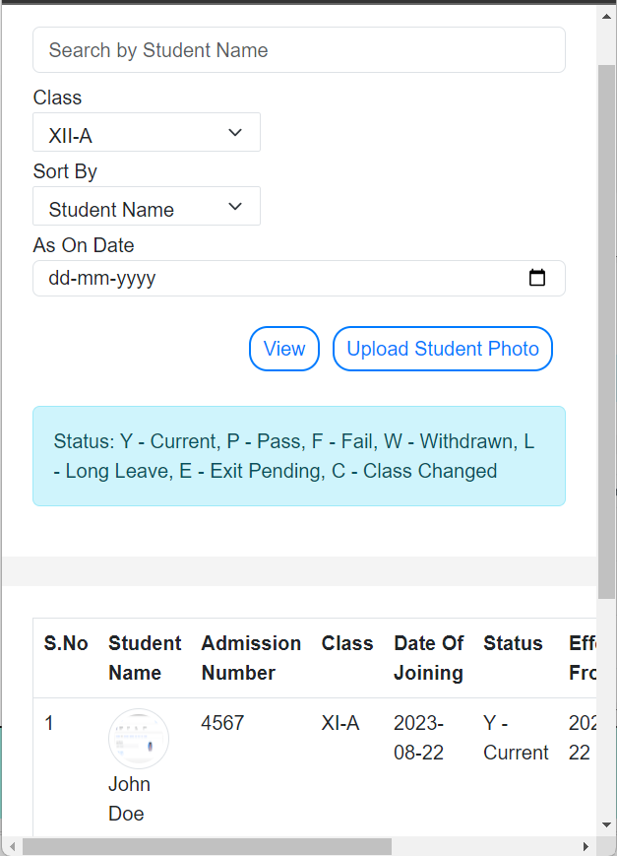

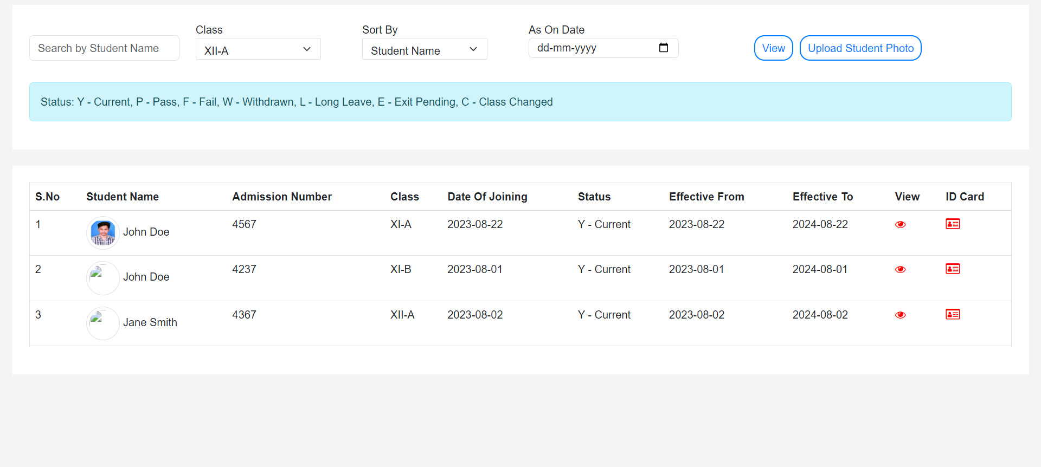
STUDENT INFORMATION
In this page it shows all the student information from the database.

Slide 6
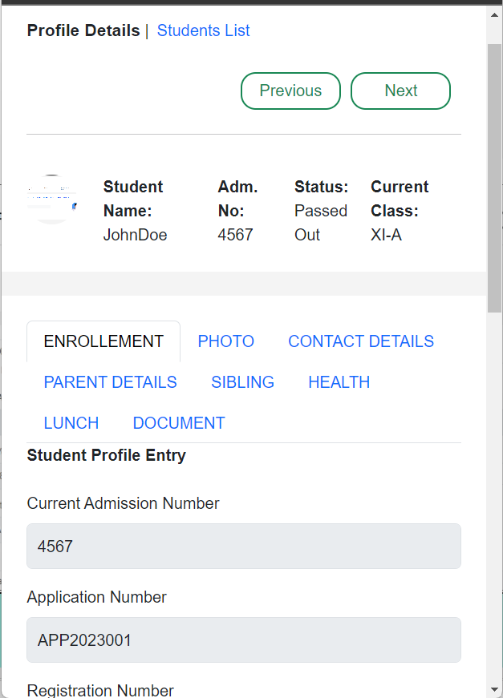

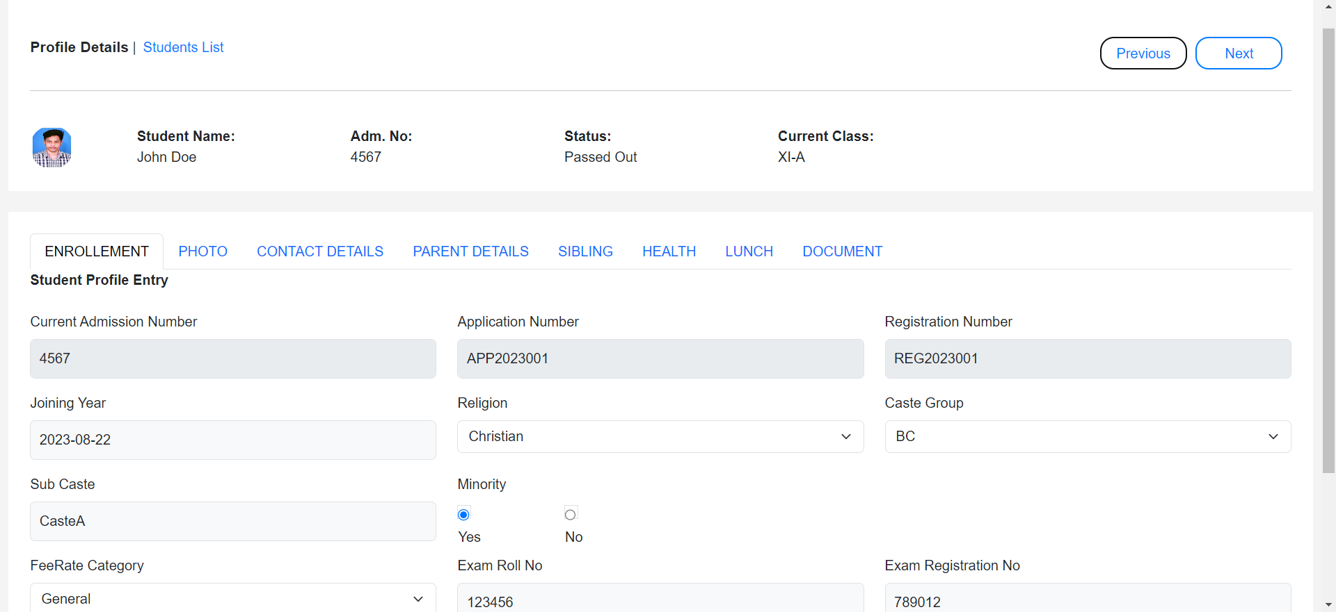
In this page it shows the individual student information from database.

Slide 7
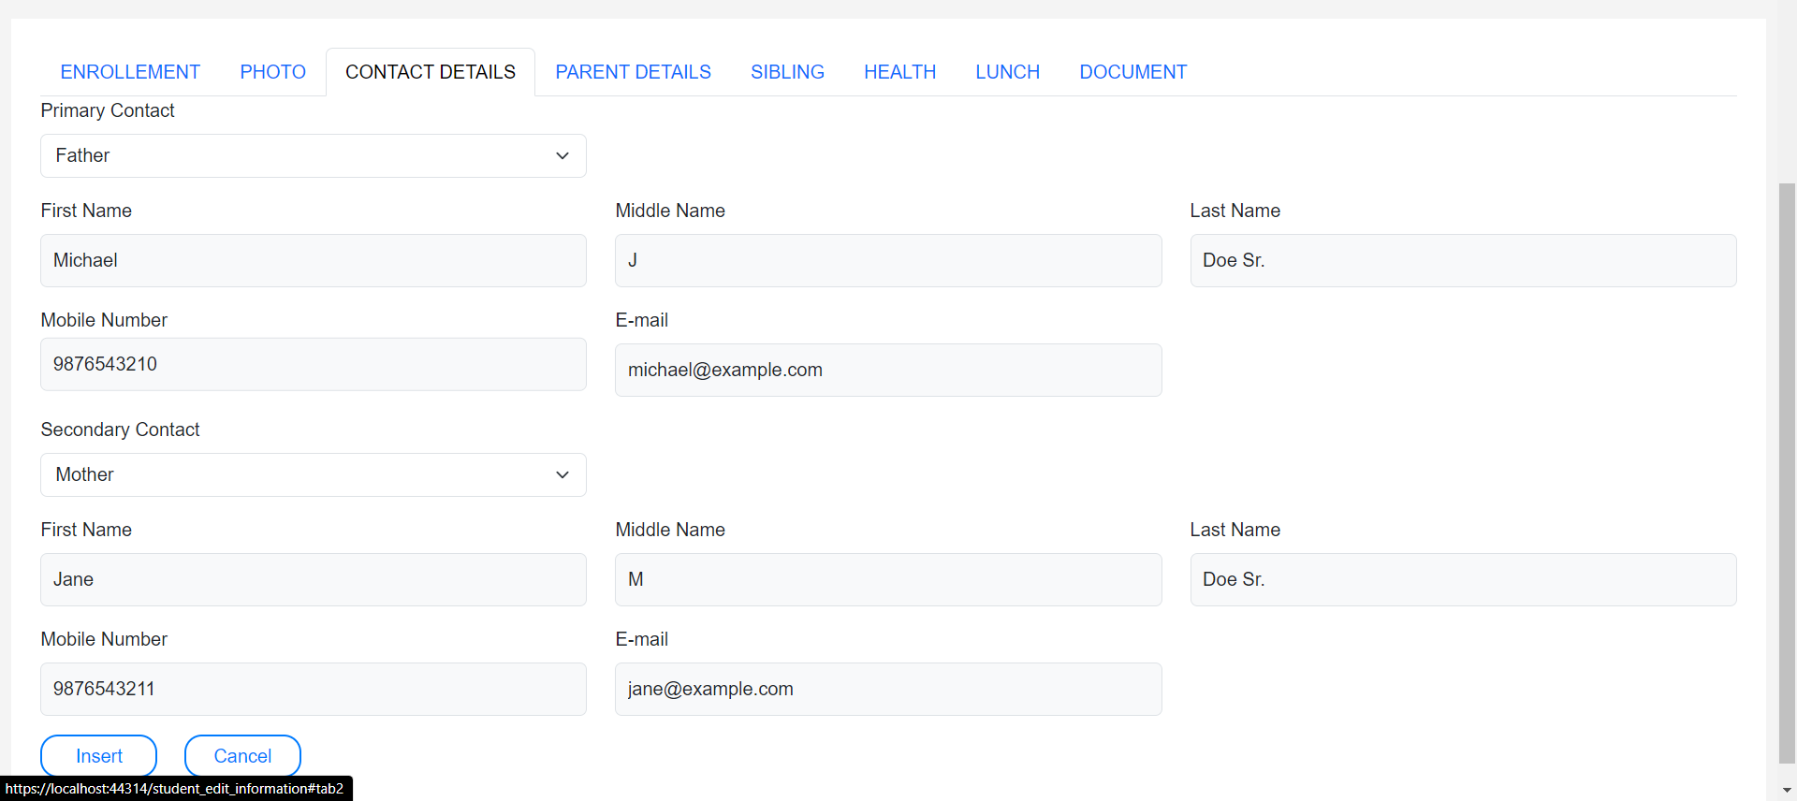


PARENTS DETAILS TAB

Slide 8
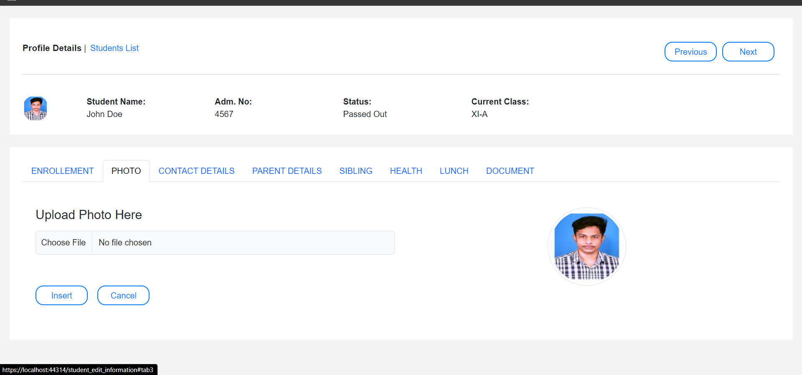
STUDENT PHOTO UPLOADING TAB
In this tab it will upload the picture of the student into the database.

Slide 9
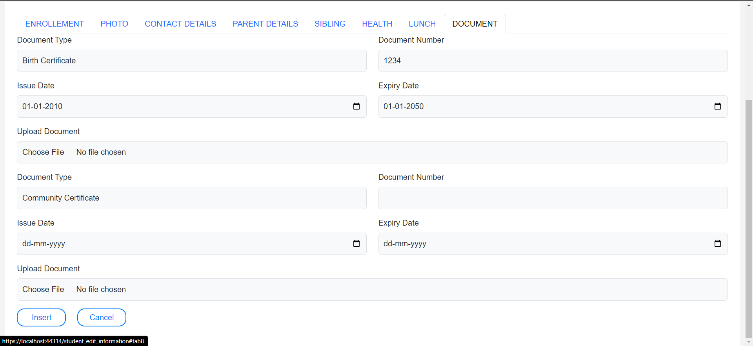
STUDENT DOCUMENT UPLOAD TAB
In this tab it uploads birth and community certificate of the student into the database

Slide 10

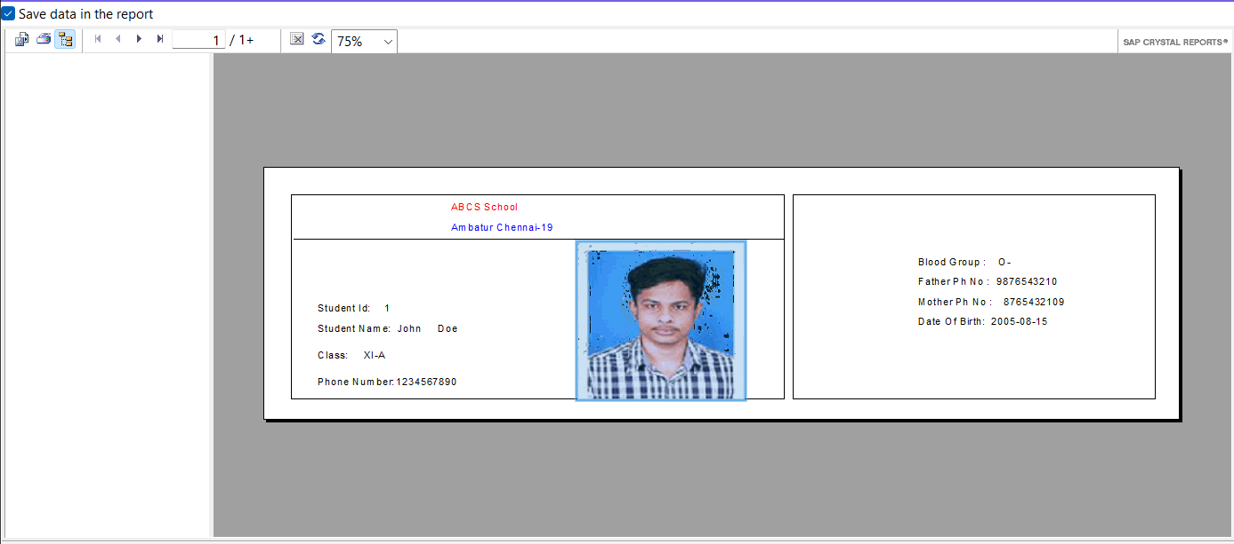
STUDENT ID GENERATION
USING CRYSTAL REPORT GENERATING ID CARDS FOR STUDENTS

Slide 11
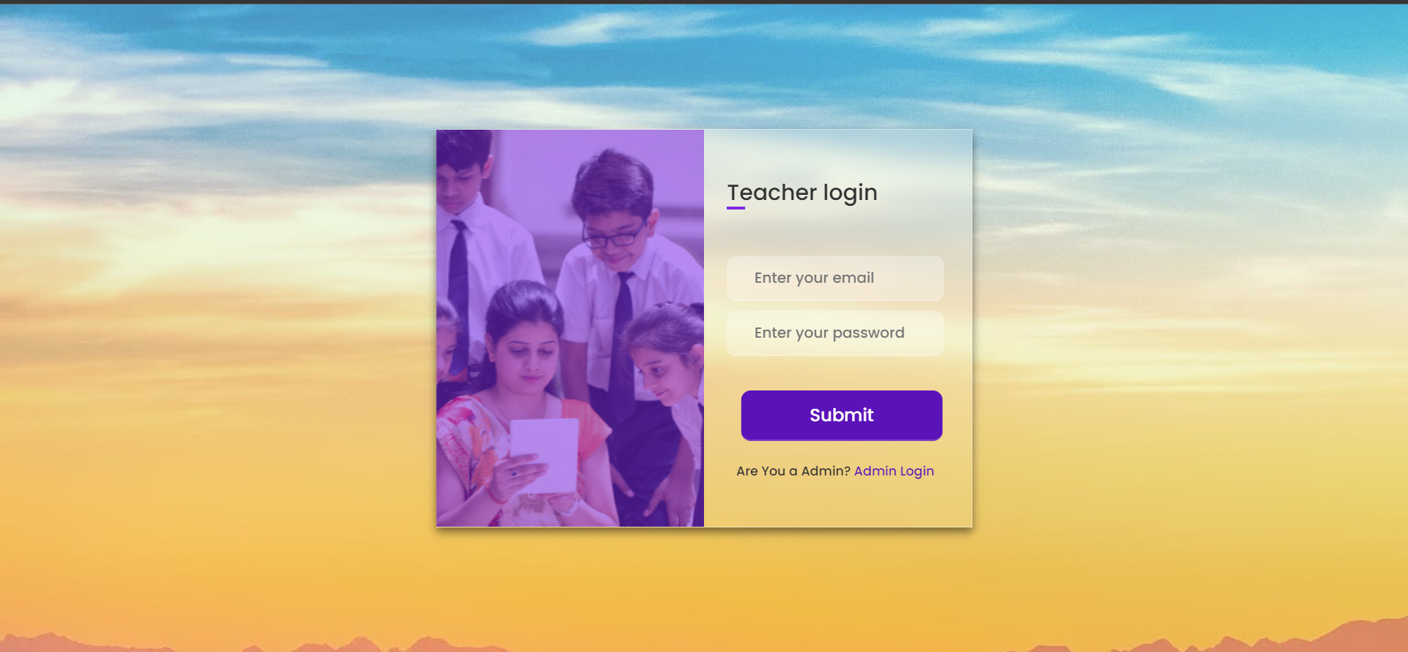
TEACHER LOGIN PAGE
In this page I have been using database authentication to authorise the Teacher.

Slide 12

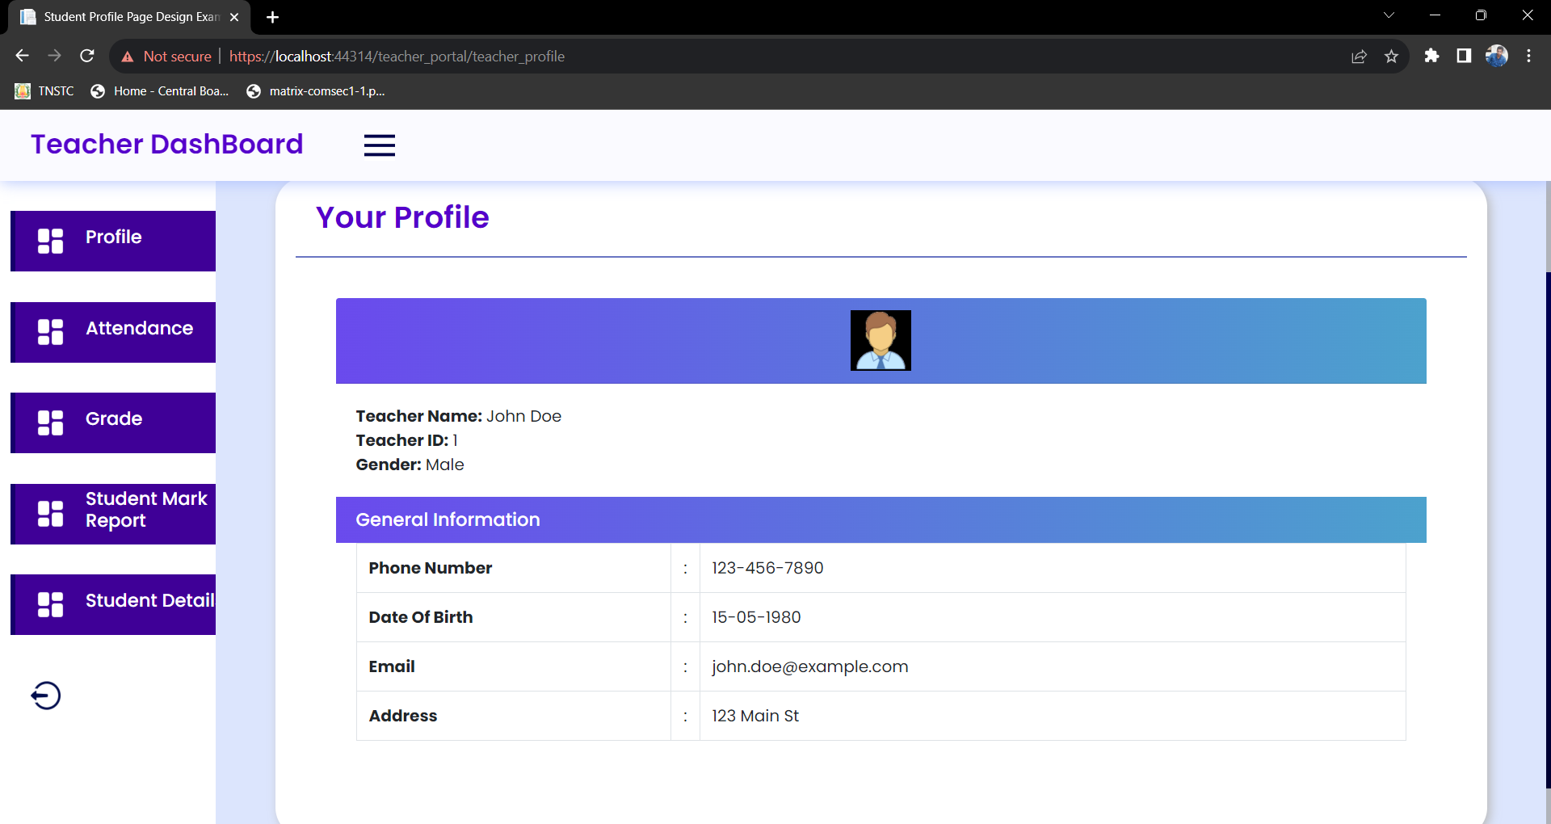
TEACHER PROFILE
In this tab it will be showing of the respective teacher’s details according to the login credentials.

Slide 13
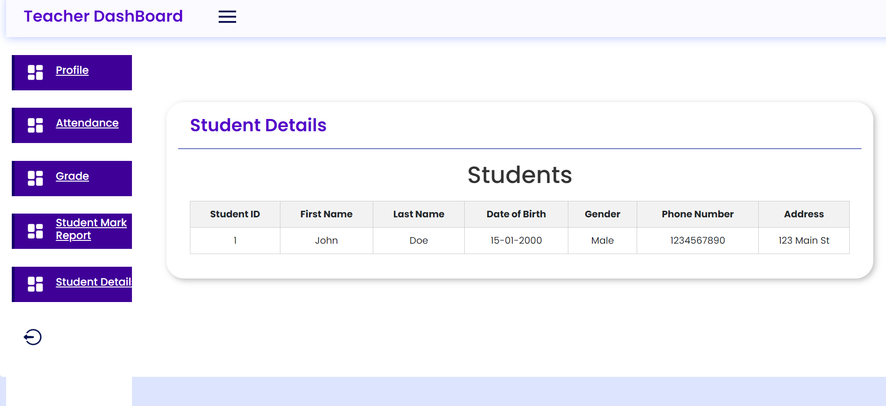
STUDENT DETAILS TAB
In this tab I will be fetching student details from the database.

Slide 14
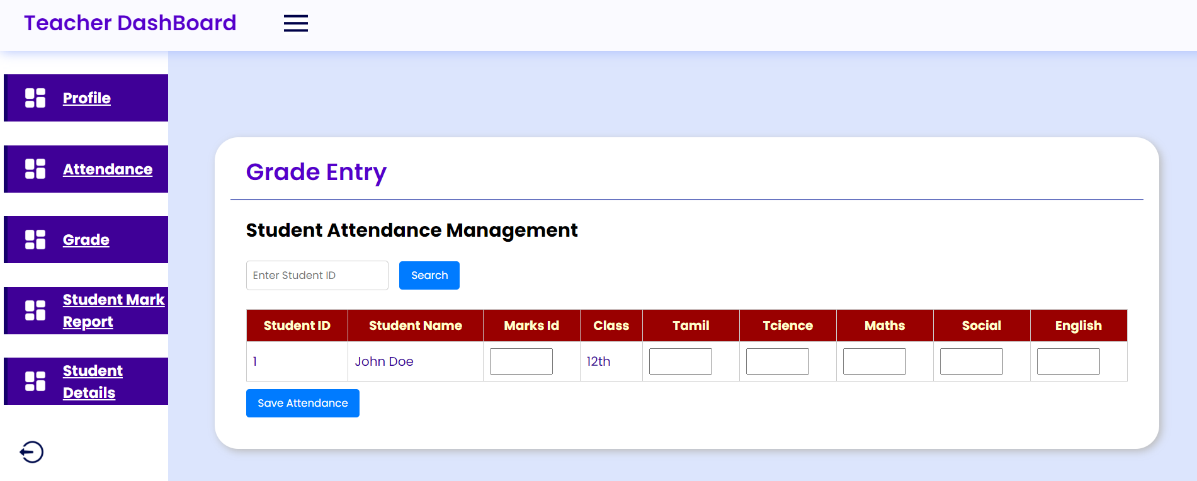
STUDENT GRADE ENTRY
In this tab it inserts grades for the respective students into the database.

Slide 15
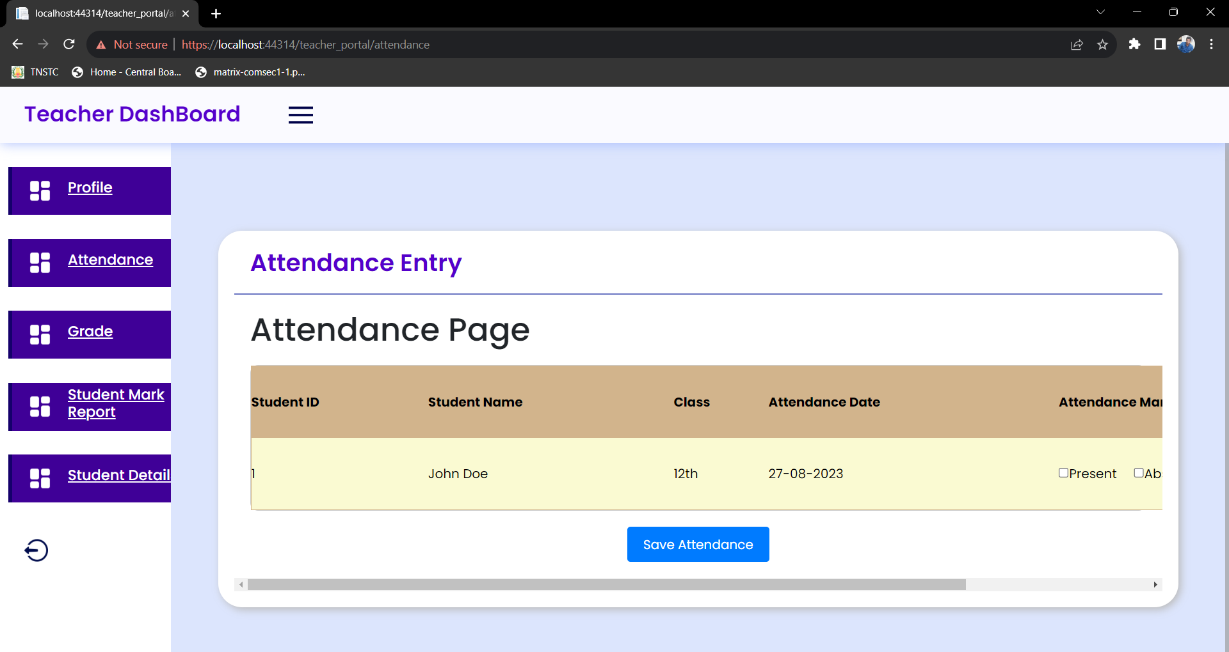
ATTENDANCE ENTRY FOR STUDENTS
In this tab it marks the attendance for the respective students and stores it in the database.

Slide 16
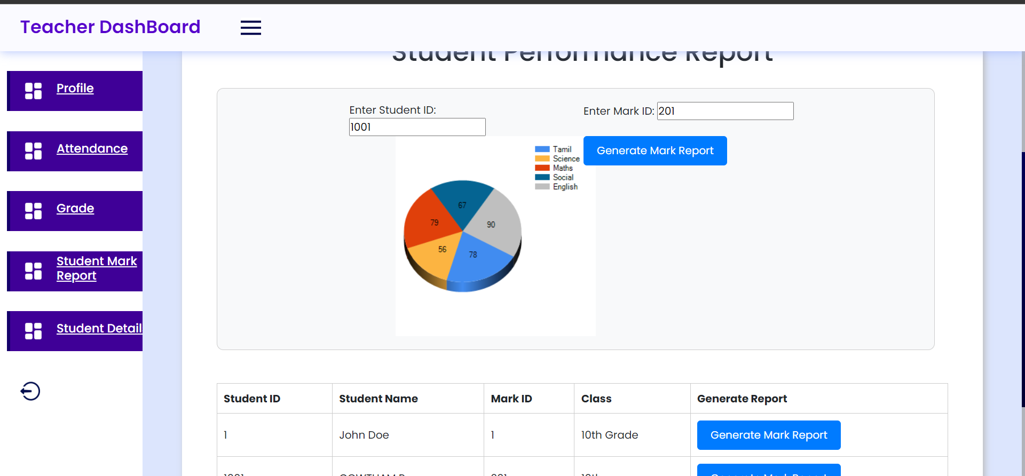
STUDENT PERFORMANCE REPORT
In this tab it shows the student’s performance report according to the marks.

Slide 17
WHAT I LEARNED DURING THIS 2 MONTHS INTERNSHIP
In SRF…

Slide 18
THANK YOU
BY GOWTHAM

